Slide 1
Anomaly Based Intrusion Detection System in IoT Networks using Random Forest

Slide 2
Problem Statement
To design and implement an anomaly Based Intrusion Detection System in IoT Networks using Random Forest which will passively monitor the IoT network traffic and alerts the user for any intrusion detected.

Slide 3
MOTIVATION
IOT devices are becoming pervasive.
Several vulnerabilities in IOT present the need for IOT security.
Build an intrusion detection system for an IOT network
Keeping in mind the low computational power of IOT devices.
Recognize zero-day attacks and distinguish between normal and anomalous behavior
Accurately identify and notify the user of an attack.

Slide 4
Objectives
To develop a model for Intrusion Detection using Random Forest algorithm.
To establish connection between IoT devices in the network and send this data to the base station.
To preprocess the IoT network data and use ML model for classification of normal vs anomalous.
To notify user at the front end if intrusion has been detected in the IoT network.

Slide 5
Literature Survey
Title | Year | Publication | Dataset | HIDS/NIDS | Anomaly/Signature | Model used | Drawbacks
Anomaly based intrusion detection system through feature selection analysis and building hybrid efficient model | 2018 | Journal of computational science 25(2018) 152-160 | NSL-KDD | NIDS | Anomaly | hybrid | Not implemented for iot devices
Towards Machine Learning Based IoT Intrusion Detection Service | 2018 | Springer International Publishing AG, part of Springer Nature 2018 | UNSW-NB15 | NIDS, cloud | Anomaly | Neural network, random forest | uses cloud computing, which increases the resource requirements
Distributed attack detection scheme using deep learning approach for Internet of Things | 2017 | Future Generation Computer Systems (2017) | NSL-KDD | NIDS, fog | Signature | Deep learning | signature based, new attacks cannot be recognised
Host based intrusion detection system with combined CNN/RNN model | 2019 | Springer Nature Switzerland AG 2019 | ADFA-LD | HIDS | Anomaly | RNN with GRU | HIDS, and not NIDS Performance doesn’t match ensemble models
Anomaly-based intrusion detection of iot device sensor data using provenance graphs | 2018 | 1st International Workshop on Security and Privacy for the Internet-of-Things (IoTSec) | longitudinal data on the thermal conditions | HIDS | Anomaly | Provenance graphs | Works with offline data, doesn’t work with real time data

Slide 6
PROJECT’S VIEWPOINT
The system, if developed correctly should be able to detect the intrusions on the IOT network, including zero-day attacks.
This mechanism adds an extra layer to the network security of the overall organization where the devices are deployed.

Slide 7
PROJECT’S END USER
Any location have a network of IOT devices is susceptible to intrusive attacks. All such networks are the end users of this intrusion detection system. For example:
Factories and companies employing a network of IOT devices.
These IOT networks are usually larger and require high level of security.
Residential complexes/ habitants employing IOT network
With increasing usage of smart homes and residential complexes using IOT devices like CCTVs, fire alarm, smoke detectors etc. , it is crucial to have a good security system for these networks

Slide 8
Projected cost of producing the product
For producing our product, we have considered the estimation cost for the end solution ie the predicted cost of the final product based on the scope and requirements.
Projected Cost = Direct Material Cost + Direct labor Cost + Overhead Cost
Direct Material Cost :- Cost of IOT node and base station (supplied by college),
Zigbee adaptor cost(required for IOT model) -> ~Rs. 400
Arduino cable -> ~Rs. 150
Direct labor cost:- Labor cost is not required here
Overhead cost:- Repair cost, rent costs
Total estimated cost -> Rs. 550

Slide 9
Is project achievable in specified (Time, Cost Budget)?
The project is achievable in specified time and cost budget.
The project can be properly planned by using these 3 achievable terms:-
1. Estimate: A prediction of how long a project will take or how much it will cost or what resources will be needed, etc.
2. Target: A statement of a desirable project objective is targeted. For connection between the IOT devices and preprocessing for classifying the data, building of intrusion detection system should be targeted first .Also time required for each model which is targeted should be estimated.
For eg –Intrusion detection model will require one week to complete
3. Commitment: A promise to deliver defined functionality at a specific level of quality by a certain date. This may be more aggressive or more conservative than the estimate.

Slide 10
Are the requirements within the scope of the project?
Our product scope is to provide security to the in any IOT network where main function of the IDS is to detect anomalous behavior to protect IOT devices.
The functional requirements like:-
Login Authentication-This requirement is within the scope as we can create a web application displaying username and password for a login page.
Network Connection-Here the data which is sensed is sent to the base station using zigbee protocol.
Training data and intrusion detection-Random forest algorithm is used to detect the category of the attack which is within the scope of the project.
Notification-Display on the web page if the attack is malicious.
The non functional requirements like performance, security ,safety, configuration of the system are also within the scope of the project because they are explicit requirements and should be taken care to avoid any unexpected errors or bugs.

Slide 11
Scope
The product can be used in any IOT network for the purpose of the security.
The product will work on network layer of the IOT System, so it can detect the intrusions which happen on the network layer.
The main function of the IDS system is to detect anomalous behavior that can be caused by the attacks. So it can be deployed anywhere where we need security measures in place to protect IOT device.
The product will only detect the intrusion but it will not take any measures to prevent the intrusion.
The prototype will be limited to two nodes and a base station, which can be further scaled to more IoT nodes.

Slide 12
Problem statement defining scope
To design and implement an anomaly Based Intrusion Detection System in IoT Networks using Random Forest which will passively monitor the IoT network traffic and alerts the user for any intrusion detected.

Slide 13
Requirements fitting into hardware
IOT nodes are embedded with Arduino microcontroller which uses Zigbee protocol for communication .
ZigBee Adaptor.
Ultraviolet sensor.

Slide 14
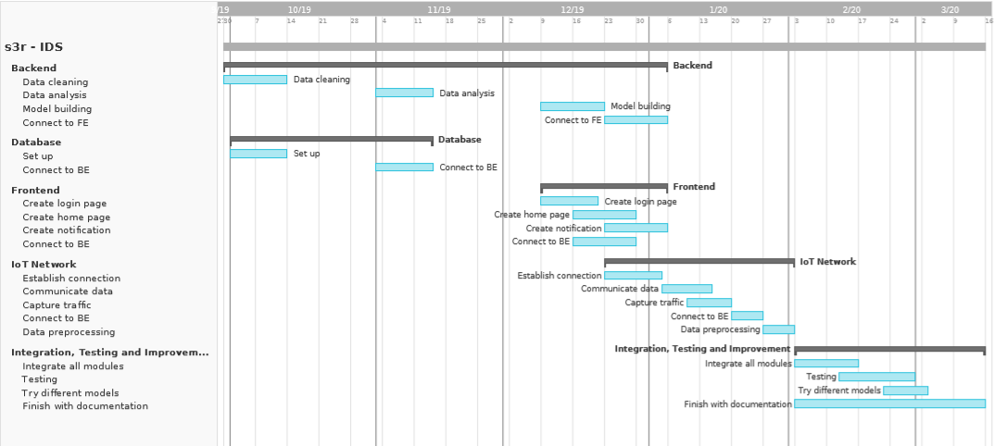
Project milestones and timeline
October
November
December
January
February
March

Slide 15
Project risks, Priority
Type of risk | Risk | Details | Priority | Backup/Solution
Schedule | Wrong time estimate Resources not tracked properly | Not able to start with IoT implementation in time Need of more hardware, learning Django, Vue (frameworks), learning IoT connectivity | Low Low/Medium | Timely schedule checks
Budget | Hardware issues | Zigbee adapter, cable needed Sensor failure | High Low | Borrow/buy Borrow/buy
Technical | Dataset issues Change in requirements | Not able to use DS2OS directly More devices needed, different sensors used, different algorithms used | High Low | Create own dataset Redesign and implement
Operational | Lack of communication Subject training | Not communicating well leading to delays, redundancy of work, wrong work Learning concepts, languages (Python, Javascript, Arduino), frameworks (Django, Vue) | Low High | Regular meetings Regular learning
External | Academic risks Health issues | Exams, submissions Members can get unwell | Low Low | Take the necessary break and work around it

